Slide 1
LISTENER and SERVLET FILTER
Instructor:

Slide 2
Table Content
EVENT AND LISTENER
SERVLET FILTER
Q&A

Slide 3
Learning Goals
After the course, attendees will be able to:
Understand Event and Listener, Web filter in Servlet
Can use to build Project

Slide 4
EVENT AND LISTENER
Section 1

Slide 5
Event and Listener in Servlet
Events are basically occurrence of something. Changing the state of an object is known as an event.
We can perform some important tasks at the occurrence of these exceptions, such as counting total and current logged-in users, creating tables of the database at time of deploying the project, creating database connection object etc.
There are many Event classes and Listener interfaces in the javax.servlet and javax.servlet.http packages.

Slide 6
Event and Listener in Servlet
Event classes
ServletRequestEvent
ServletContextEvent
ServletRequestAttributeEvent
ServletContextAttributeEvent
HttpSessionEvent
HttpSessionBindingEvent
Event interfaces
ServletRequestListener
ServletRequestAttributeListener
ServletContextListener
ServletContextAttributeListener
HttpSessionListener
HttpSessionAttributeListener
HttpSessionBindingListener
HttpSessionActivationListener

Slide 7
HttpSessionEvent and HttpSessionListener
The HttpSessionEvent is notified when session object is changed.
The corresponding Listener interface for this event is HttpSessionListener.
We can perform some operations at this event such as counting total and current logged-in users, maintaing a log of user details such as login time, logout time etc.
Methods of HttpSessionListener interface:
public void sessionCreated(HttpSessionEvent e): is invoked when session object is created.
public void sessionDestroyed(ServletContextEvent e): is invoked when session is invalidated.

Slide 8
HttpSessionEvent and HttpSessionListener
Example: to count total and current logged-in users
login.html: to get input from the user.
CountUserListener.java: A listener class that counts total and current logged-in users and stores this information in ServletContext object as an attribute.
LoginServlet.java: A Servlet class that creates session and prints the total and current logged-in users.
LogoutServlet.java: A Servlet class that invalidates session.

Slide 9
HttpSessionEvent and HttpSessionListener
Login.html
LoginServlet.java
<head>
<title>Login</title>
</head>
<form action="login">
Name:<input type="text" name="username"><br>
Password:<input type="password" name="userpass"><br>
<input type="submit" value="Login" />
</form>
@WebServlet("/login")
public class LoginServlet extends HttpServlet {
public void doGet(HttpServletRequest request, HttpServletResponse response)
throws ServletException, IOException {
response.setContentType("text/html");
PrintWriter out = response.getWriter();
String userName =request.getParameter("username");
out.print("Welcome " + userName);
HttpSession session=request.getSession();
session.setAttribute("uname", userName);
ServletContext ctx=getServletContext();
int t=(Integer)ctx.getAttribute("totalusers");
int c=(Integer)ctx.getAttribute("currentusers");
out.print("<br>Total users= "+t);
out.print("<br>Current users= "+c);
out.print("<br><a href='logout'>logout</a>");
out.close();
}
}

Slide 10
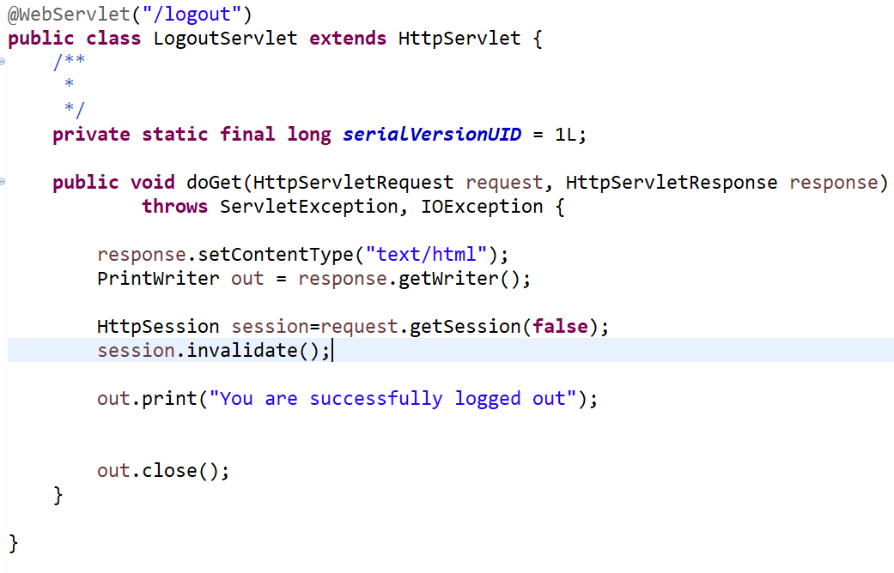
HttpSessionEvent and HttpSessionListener
LogoutServlet.java

Slide 11
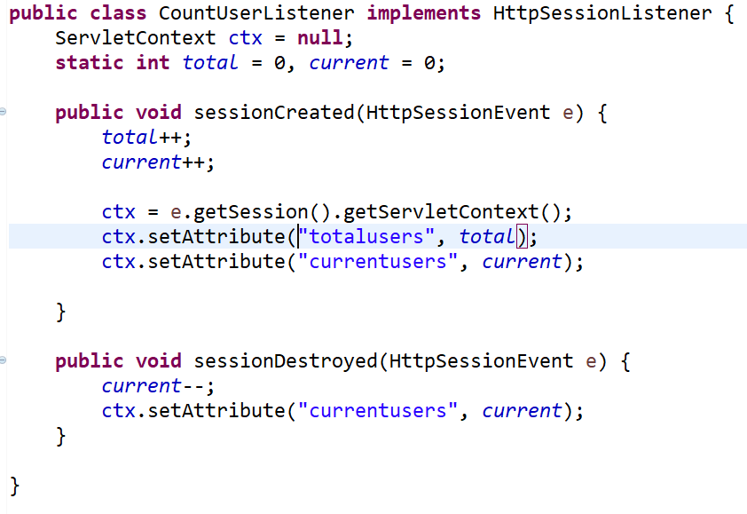
HttpSessionEvent and HttpSessionListener
CountUserListener.java
Web.xml
<listener>
<listener-class>CountUserListener</listener-class>
</listener>

Slide 12
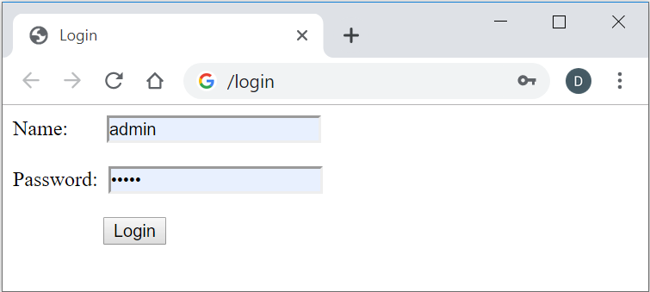
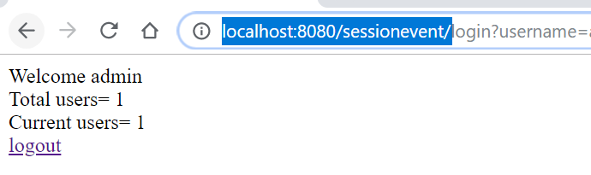
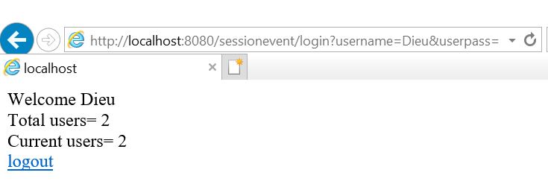
HttpSessionEvent and HttpSessionListener
Login.html
After an user login:
After two user login:

Slide 13
HttpSessionBindingListener
Can be implemented by a class to get notified when its instance is added to the session or when it is removed from the session.
HttpSessionBindingListener#valueBound() is invoked when this object is added to the session by the use of HttpSession.setAttribute().
HttpSessionBindingListener#valueUnbound() is invoked when this object is removed from the session. That happens when
HttpSession.removeAttribute() is used for this object.
Or HttpSession.invalidate() is used.
Or after some time of session timeout.

Slide 14
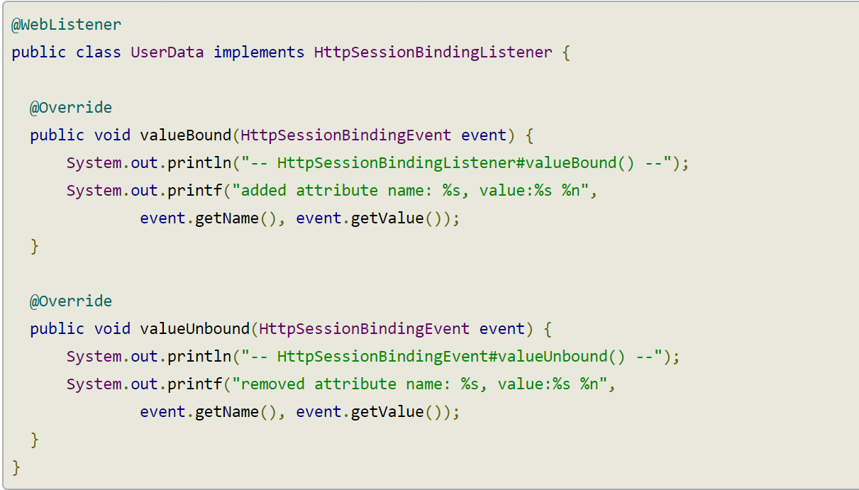
HttpSessionBindingListener
Example
Step1: Implementing HttpSessionBindingListener
Notes:
@WebListener
public class UserData implements HttpSessionBindingListener {
@Override
public void valueBound(HttpSessionBindingEvent event) {
System.out.println("-- HttpSessionBindingListener#valueBound() --");
System.out.printf("added attribute name: %s, value:%s %n",
event.getName(), event.getValue());
}
@Override
public void valueUnbound(HttpSessionBindingEvent event) {
System.out.println("-- HttpSessionBindingEvent#valueUnbound() --");
System.out.printf("removed attribute name: %s, value:%s %n",
event.getName(), event.getValue());
}
}

Slide 15
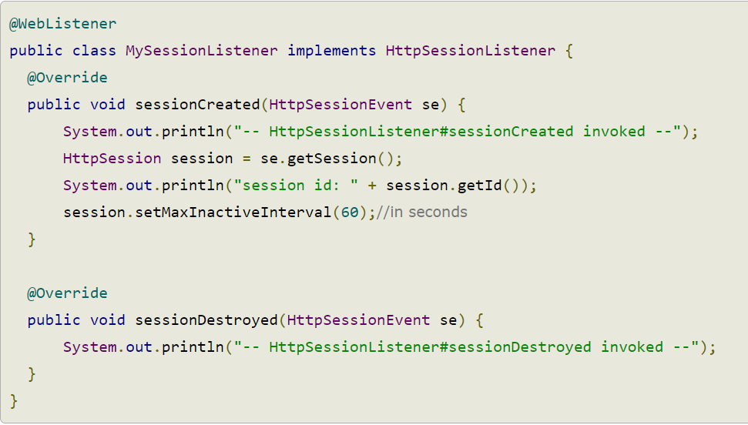
HttpSessionBindingListener
Implementing HttpSessionListener
We are also implementing HttpSessionListener to set a session timeout value and also to print messages to see the relative lifecycle notification of the session itself.
Notes:
@WebListener
public class MySessionListener implements HttpSessionListener {
@Override
public void sessionCreated(HttpSessionEvent se) {
System.out.println("-- HttpSessionListener#sessionCreated invoked --");
HttpSession session = se.getSession();
System.out.println("session id: " + session.getId());
session.setMaxInactiveInterval(60);//in seconds
}
@Override
public void sessionDestroyed(HttpSessionEvent se) {
System.out.println("-- HttpSessionListener#sessionDestroyed invoked --");
}
}

Slide 16
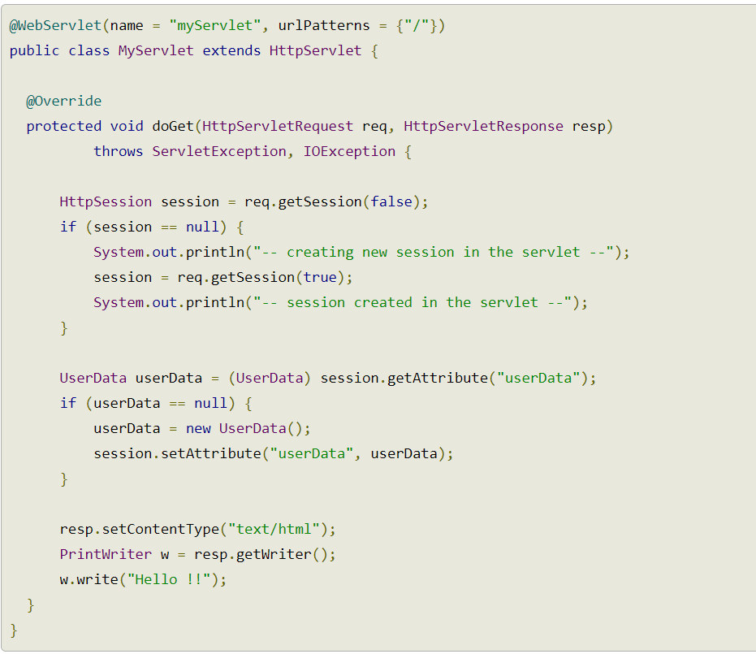
HttpSessionBindingListener
Step2: Create a MyServlet class
Notes:
@WebServlet(name = "myServlet", urlPatterns = {"/"})
public class MyServlet extends HttpServlet {
@Override
protected void doGet(HttpServletRequest req, HttpServletResponse resp)
throws ServletException, IOException {
HttpSession session = req.getSession(false);
if (session == null) {
System.out.println("-- creating new session in the servlet --");
session = req.getSession(true);
System.out.println("-- session created in the servlet --");
}
UserData userData = (UserData) session.getAttribute("userData");
if (userData == null) {
userData = new UserData();
session.setAttribute("userData", userData);
}
resp.setContentType("text/html");
PrintWriter w = resp.getWriter();
w.write("Hello !!");
}
}

Slide 17
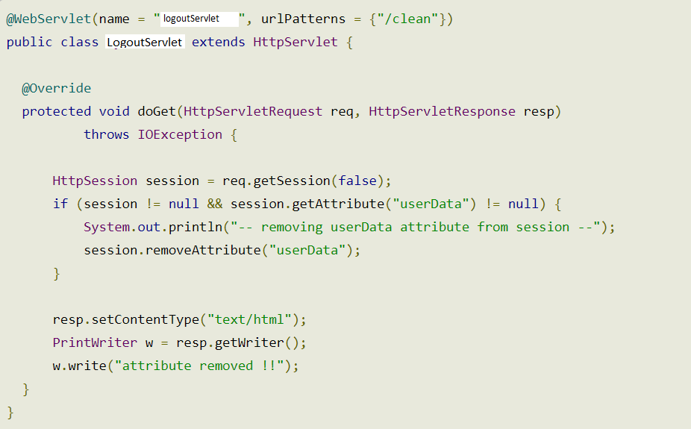
HttpSessionBindingListener
Step3: Create a LogoutServlet class to removes 'UserData' attribute from the session.
Notes:
@WebServlet(name = “logoutServlet", urlPatterns = {"/clean"})
public class LogoutServlet extends HttpServlet {
@Override
protected void doGet(HttpServletRequest req, HttpServletResponse resp)
throws IOException {
HttpSession session = req.getSession(false);
if (session != null && session.getAttribute("userData") != null) {
System.out.println("-- removing userData attribute from session --");
session.removeAttribute("userData");
}
resp.setContentType("text/html");
PrintWriter w = resp.getWriter();
w.write("attribute removed !!");
}
}

Slide 18
HttpSessionBindingListener
Output
Accessing http://localhost:8080/ from browser, prints the following on the console:
http://localhost:8080/clean prints the following:
-- creating new session in the servlet --
-- HttpSessionListener#sessionCreated invoked --
session id: 56A239430222B1CBE8A8A5DDFB764AFD
-- session created in the servlet --
-- HttpSessionBindingListener#valueBound() --
added attribute name: userData, value:com.logicbig.example.UserData@4d7c522
-- removing userData attribute from session --
-- HttpSessionBindingEvent#valueUnbound() --
removed attribute name: userData, value:com.logicbig.example.UserData@604a95c7

Slide 19
SERVLET FILTER
Section 2

Slide 20
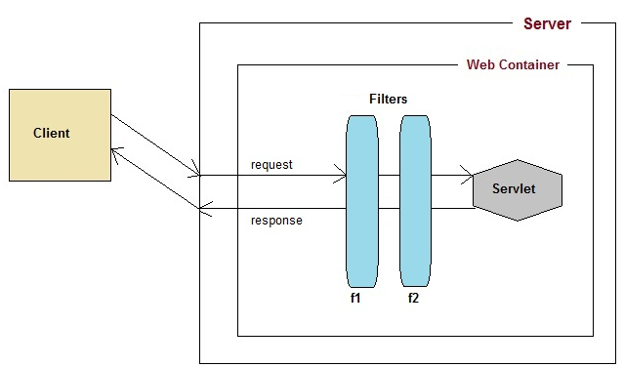
Introduction to Filter API
Filters are compontents that you can use and configure to perform some filtering tasks.
Filter is used for pre-processing of requests and post-processing of responses.

Slide 21
Introduction to Filter API (2/2)
For creating a filter, we must implement Filter interface. Filter interface gives the following life cycle methods for a filter:
void init(FilterConfig filterConfig): invoked by the web container to indicate to a filter that it is being placed into service.
void doFilter(ServletRequest request, ServletResponse response, FilterChain chain): invoked by the container each time a request/response pair is passed through the chain due to a client request for a resource at the end of the chain.
void destroy(): invoked by the web container to indicate to a filter that it is being taken out of service.

Slide 22
Servlet Filter
Usage of Filter
recording all incoming requests
logs the IP addresses of the computers from which the requests originate
conversion
data compression
encryption and decryption
input validation etc.
Advantage of Filter
Filter is pluggable.
One filter don't have dependency onto another resource.
Less Maintenance

Slide 23
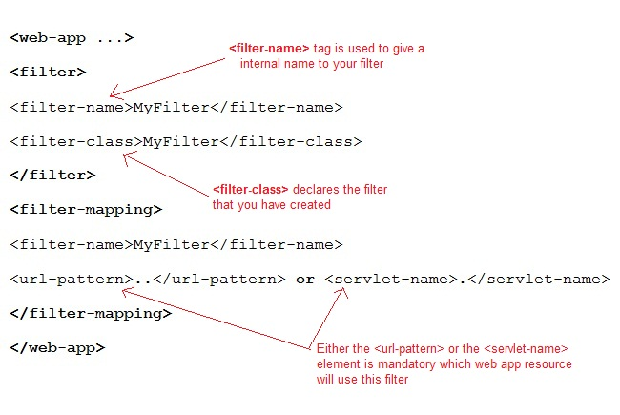
Deployment Descriptor

Slide 24
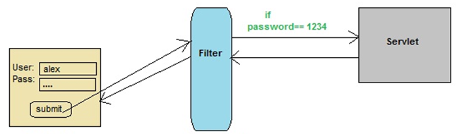
Practical time
In this example we are using Filter to authenticate:
LoginServlet
user_login.jsp
AppFilter

Slide 25
Summary
EVENT AND LISTENER
SERVLET FILTER
Q&A

Slide 26

Thank you
‹#›

